Slide 1
PROBABILITY AND STATISTICS
Notes:
galvanizeopensource.github.io/stats-shortcourse

Slide 2

Probability
Probability = $\frac{\text{\# }\text{outcomes} \text{we} \text{like}}{\text{\# }\text{total} \text{possible}\text{ (}\text{equally} \text{likely}\text{) }\text{outcomes} }$

Slide 3
Interesting issue with this definition:
What is the probability that I will die this year?

Slide 4
Simple Probability
Just a matter of counting
(Permutations and Combinations)
Tons of good online resources.
Notes:
http://www.dcrossantiques.com/locks/ADDmillerPERMUTAIONlock.jpg
https://i2.wp.com/roomescapeartist.com/wp-content/uploads/2017/12/Philosoraptor-Combination-Locks.jpg?ssl=1

Slide 5
INDEPENDENCE AND MUTUAL EXCLUSIVITY

Slide 6
Independence and Mutual Exclusivity
What are they?
What happens if two events are independent or mutually exclusive?
What happens if they aren't?

Slide 7
Independence

Slide 8
INDEPENDENCE
In probability theory, two events are independent if the occurrence of one does not affect the probability of occurrence of the other.
(text adapted from Wikipedia)

Slide 9
INDEPENDENCE
Another way to look at it – does knowing the result of one event tell you anything about the other event?
- Rolling a 6 and then rolling another 6.
- Selecting a 6 from a deck of cards and then selecting another 6.
- Having sushi for lunch and having sushi for dinner.

Slide 10

INDEPENDENCE
If A and B are independent, $P\left(A and B\right)=\text{P}\text{(}\text{A} \text{and} \text{B}\text{) = }\text{P}\text{(}\text{A}\text{) ∗ }\text{P}\text{(}\text{B}\text{)}$
The probability of my friend in DC missing her train to work is 10% and the probability of my friend in NY missing her train to work is 30%.
What is the probability that both friends will miss the train tomorrow?
Notes:
Independent, then P(A and B) = P(A)*P(B)
Exclusive, then P(A or B) = P(A) + P(B)

Slide 11
Visualization
INDEPENDENCE

Slide 12
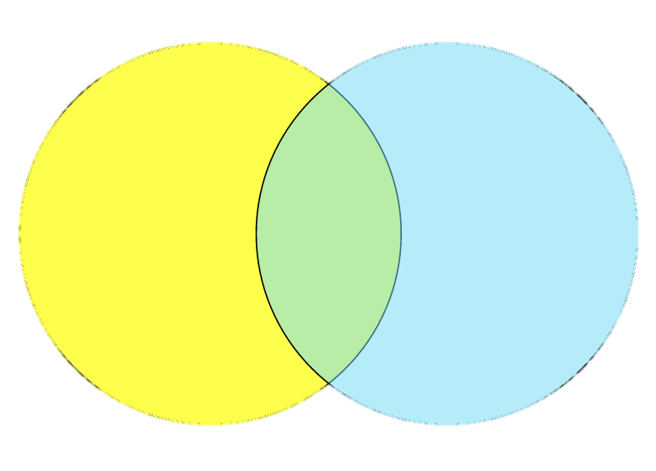

What if they aren't INDEPENDENT?
I roll a single die. What is the probability of it being odd and greater than three?
$$P\left(A and B\right) =P\left(A\right)∗P\left(B\right)$$
$$P\left(odd and>3\right) =P\left(odd\right)∗P\left(>3\right)$$
$=\frac{1}{2}∗\frac{1}{2}=\frac{1}{4}$
odd
> 3
(WRONG)
Notes:
expect 5/6
P(odd) + P(>3) – P(odd and >3)

Slide 13

What if they aren't INDEPENDENT?
I roll a single die. What is the probability of it being odd and greater than three?
$$P\left(A and B\right) =P\left(A\right)∗P\left(B|A\right)$$
$$P\left(odd and>3\right) =P\left(odd\right)∗P\left(>3|odd\right)$$
$=\frac{1}{2}∗\frac{1}{3}=\frac{1}{6}$
odd
> 3
(RIGHT)

Slide 14
EXAMPLE
 | Percent of School Pop | Percent Left-Handed
Freshman | 20% | 10%
Sophomore | 25% | 15%
Junior | 25% | 8%
Senior | 30% | 12%
odd
> 3
If I choose a student at random, what is the probability that the student is a left-handed junior?
Notes:
3/6 * 1/3 = 3/9
Pr(A|B)=Pr(A∩B)Pr(B)

Slide 15
Mutually Exclusive

Slide 16
MUTUAL EXCLUSIVITY
In probability theory, two events are mutually exclusive if they cannot both occur (be true).
(text adapted from Wikipedia)

Slide 17

MUTUAL EXCLUSIVITY
If A and B are mutually exclusive, $P\left(A or B\right)=\text{P}\text{(}\text{A}\text{) + }\text{P}\text{(}\text{B}\text{)}$
The probability of getting sushi for dinner is 20% and the probability of getting Thai for dinner is 30%.
What is the probability of getting sushi or Thai?
Notes:
Independent, then P(A and B) = P(A)*P(B)
Exclusive, then P(A or B) = P(A) + P(B)

Slide 18
Visualization
MUTUAL EXCLUSIVITY

Slide 19

What if they aren't MUTUALLY EXCLUSIVE?
I roll a single die. What is the probability of it being odd or greater than three?
$$P\left(A or B\right) =P\left(A\right)+P\left(B\right)$$
$$P\left(odd or>3\right) =P\left(odd\right)+P\left(>3\right)$$
$=\frac{1}{2}+\frac{1}{2}=1$
odd
> 3
(WRONG)
Notes:
expect 5/6
P(odd) + P(>3) – P(odd and >3)

Slide 20

What if they aren't MUTUALLY EXCLUSIVE?
I roll a single die. What is the probability of it being odd or greater than three?
$$P\left(A or B\right) =P\left(A\right)+P\left(B\right)−P(A and B)$$
$P\left(odd or>3\right) =P\left(odd\right)+P\left(>3\right)−P(odd and>3)$
$=\frac{1}{2}+\frac{1}{2}−\frac{1}{6}=\frac{5}{6}$
odd
> 3
(RIGHT)
Notes:
expect 5/6
P(odd) + P(>3) – P(odd and >3)

Slide 21
EXAMPLE
I draw a card from a regular deck of playing cards. What is the probability that the card is a diamond or a face card?

Slide 22
Independence vs Mutual Exclusivity
Independent and Mutually Exclusive | Independent but not Mutually Exclusive
Not Independent but Mutually Exclusive | Neither Independent nor Mutually Exclusive
Notes:
Independent, then P(A and B) = P(A)*P(B)
Exclusive, then P(A or B) = P(A) + P(B)

Slide 23
Break?
Notes:
https://www.google.com/url?sa=i&rct=j&q=&esrc=s&source=images&cd=&cad=rja&uact=8&ved=2ahUKEwjfyb_2jf_cAhUE-lQKHSGdBoYQjRx6BAgBEAU&url=https%3A%2F%2Fwww.deviantart.com%2Fcloudnayn10%2Fart%2FSchool-Break-713301717&psig=AOvVaw2NAUAHZpwfhLUFgeGoIFQ5&ust=1534973974839680

Slide 24
BAYES RULE
Notes:
https://pictures.abebooks.com/isbn/9780956372840-us.jpg
http://www.mathisintheair.org/wp/wp-content/uploads/2016/02/bayes.gif

Slide 25
Bayes Rule
 | Percent of School Pop | Percent Left-Handed
Freshman | 20% | 10%
Sophomore | 25% | 15%
Junior | 25% | 8%
Senior | 30% | 12%
Before: If I choose a student at random, what is the probability that the student is a left-handed junior?
Now: If I choose a student at random and he is left handed, what is the probability that the student is a junior?

Slide 26
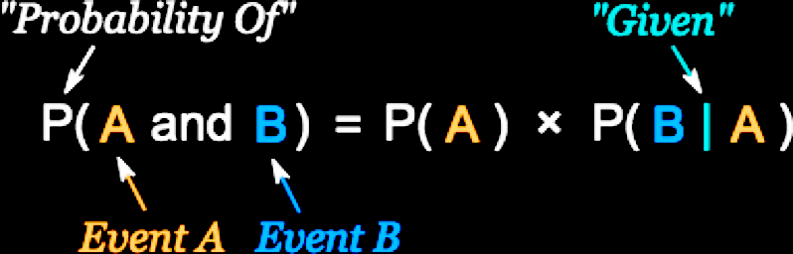

Bayes Rule
The Algebra:
$P(A and B) = P(B and A)$
$P(A)∗P(B|A) = P(B)∗P(A|B)$
$divide both sides by P(A): P(B|A) = \frac{P\left(B\right) ∗ P(A|B)}{P(A) }$
Notes:
P(A and B) = P(A) * P(B|A)
P(A and B) = P(B and A)
P(A)*P(B|A) = P(B)*P(A|B)
divide both sides by P(B|A):
P(A) = P(B)*P(A|B) / P(B|A)

Slide 27

Bayes Rule
odd
> 3
The Visual:
The probability of being odd
given that
a die roll is greater than three
A:
B:
$$P(B|A) = \frac{P\left(B\right) ∗ P(A|B)}{P(A) }$$
Notes:
expect: 1/3
A: greater than three
B: being odd
P(being odd) * P(greater than three given odd) / P(greater than three) = ½ * 1/3 / 1/3

Slide 28
Example:
 | Percent of School Pop | Percent Left-Handed
Freshman | 20% | 10%
Sophomore | 25% | 15%
Junior | 25% | 8%
Senior | 30% | 12%
If I choose a student at random and he is left handed, what is the probability that the student is a junior?

Slide 29
Example:
A routine test for HIV came back positive. What is the chance that you have HIV?
0.5 % of US adults have HIV
The test isn't 100% perfect.
If you have HIV it catches it 98% of the time.
If you don’t have HIV it gives a false positive 3% of the time.

Slide 30

MATH:
0.5 % of US adults have HIV
The test isn't 100% perfect.
If you have HIV it catches it 98% of the time.
If you don’t have HIV it gives a false positive 3% of the time.
$$P(HIV|+test) =\frac{P(+test|HIV) P(HIV)}{P(+test) }$$
$$P(+test|HIV+) = .98$$
$$P(HIV) = .005$$
$$P(+test) = P(HIV+ and +test) + P(HIV− and +test)$$
$= P\left(HIV−\right) P\left(+test | HIV−\right)+ P\left(HIV+\right) P(+test|HIV+)$
$=\left(.995\right)\left(.03\right) + \left(.005\right)\left(.98\right)$
$= 0.03475$
$$P(HIV+|+test) = (.98)(.005)/(0.03475) = 0.14100719424$$
Notes:
P(HIV|+test) = P(+test|HIV) P(HIV) / P(+test)
P(+test|HIV+) = .98
P(HIV) = .005
P(+test) = P(HIV+ and +test) + P(HIV- and +test)
= P(HIV-)P(+test|HIV-) + P(HIV+)P(+test|HIV+)
=(.995)(.03) + (.005)(.98) = 0.03475
P(HIV|+test) = (.98)(.005)/(0.03475) = 0.14100719424

Slide 31
Visualization:
0.5 % of US adults have HIV
The test isn't 100% perfect.
If you have HIV it catches it 98% of the time.
If you don’t have HIV it gives a false positive 3% of the time.
250,000,000 US adults, they all take the test
250,000,000 * .005 = 1,250,000 have HIV
1,250,000 * .98 = 1,225,000 get a true positive
1,250,000 * .02 = 25,000 get a false negative
250,000,000 * .995 = 248,750,000 don't have HIV
248,750,000 * .97 = 241,287,500 get a true negative
248,750,000 * .03 = 7,462,500 get a false positive
1,225,000 + 7,462,500 have a positive test
Notes:
all positive = TP + FP = 1,225,000 + 7,462,500 = 8,687,500
prob of false positive = 7,462,500 / 8,687,500 = .86

Slide 32
Practice #1 (answer online)
odd
> 3
 | Percent of School Pop | Percent Left-Handed
Freshman | 20% | 10%
Sophomore | 25% | 15%
Junior | 25% | 8%
Senior | 30% | 12%
If I choose a student at random, what is the probability that the student is a right handed senior?
Notes:
P(sr and rt handed) = P(sr)* P(rt|sr) = (.3)*(.12) = .036

Slide 33
Practice #2 (answer online)
odd
> 3
 | Percent of School Pop | Percent Left-Handed
Freshman | 20% | 10%
Sophomore | 25% | 15%
Junior | 25% | 8%
Senior | 30% | 12%
My new friend is left handed. What is the chance that my friend is a sophomore? (left handed students make up 11.35% of the school population)
Notes:
P(soph|lft) = P(soph)P(lft|soph) / P(lft) = (.25)*(.15) / (.2*.1)+(.25*.15)+(.25*.08)+(.3*.12) = (.25)*(.15) / .1135 = 33%

Slide 34
Practice #3 (answer online)
I have two coins, one normal (50% heads, 50% tails), one weighted to be 80% heads and 20% tails. I randomly choose a coin and flip it. It lands as heads. What is the chance that I chose the fair coin?
Notes:
P(fair|heads) = P(fair)P(heads|fair) / P(heads) = .5*.5 / (.5*.5)+(.5*.8) = .38

Slide 35
Notes:
https://qph.fs.quoracdn.net/main-qimg-ed318384ec2e55ed3f6b834dd6025ba4-c

Slide 36
"Review"
$P\left(A and B\right)=P\left(A\right)P\left(B | A\right)$
$P\left(A or B\right)=P\left(A\right)+P\left(B\right)−P\left(A and B\right)$
Bayes Theorem: $P\left(A | B\right)=\frac{P\left(B | A\right)P\left(A\right)}{P\left(B\right)}$
odd
> 3
Notes:
P(A and B) = P(A) * P(B|A)
P(A or B) = P(A) + P(B) – P(A and B)

Slide 37
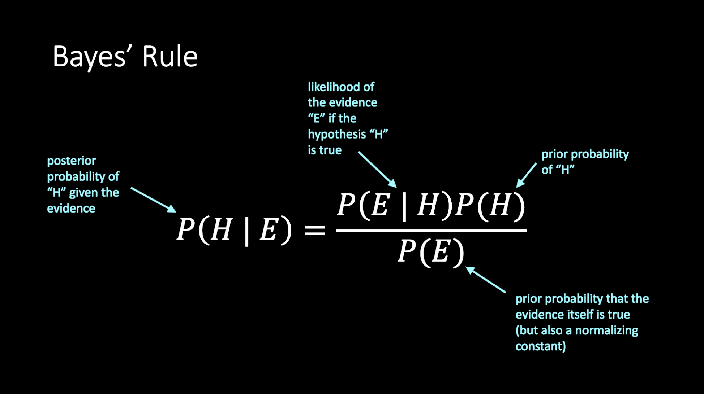
Bayesian Inference

Slide 38
You have two coins and pick one at random. One is fair (50-50 heads-tails) the other is biased (75-25 heads-tails). You flip it three times and it comes up heads all three times. Which coin do you think you have? (no math)
Question 1:

Slide 39


You have two coins and pick one at random. One is fair (50-50 heads-tails) the other is biased (75-25 heads-tails). You flip it three times and it comes up heads all three times. Which coin do you think you have? Part 1: What is the probability you have the biased coin?
Question 1:
$$P\left(biased | HHH\right)=\frac{P\left(HHH | biased\right)P\left(biased\right)}{P\left(HHH\right)}$$
$$=\frac{\left(.422\right)(.5)}{\left(.273\right)}=.77$$

Slide 40

You have two coins and pick one at random. One is fair (50-50 heads-tails) the other is biased (75-25 heads-tails). You flip it three times and it comes up heads all three times. Which coin do you think you have? Part 1 (cont): Which coin do you think you have?
Question 1:
$$P\left(biased | HHH\right)$$
$$P\left(fair | HHH\right)$$
$$=\frac{\left(.422\right)(.5)}{\left(.273\right)}=.77$$
$$=\frac{\left(.125\right)(.5)}{\left(.273\right)}=.23$$

Slide 41


You have two coins and pick one at random. One is fair (50-50 heads-tails) the other is biased (75-25 heads-tails). You flip it three times and it comes up heads all three times. Which coin do you think you have? Part 2: How would your answer change if you started with a bin of 1000 coins, only one of which is biased?
Question 1:
$$P\left(biased | HHH\right)$$
$$P\left(fair | HHH\right)$$
$$=\frac{\left(.422\right)(.001)}{\left(.1253\right)}=.003$$
$$=\frac{\left(.125\right)(.999)}{\left(.1253\right)}=.997$$

Slide 42


Example: Document classification
We want to classify New York Times articles into sports and fashion.
We can only see a single word and it's "coach".
$$P\left(sports | "coach"\right)=\frac{P\left("coach" | sports\right)P\left(sports\right)}{P\left("coach"\right)}$$
$$P\left(fashion | "coach"\right)=\frac{P\left("coach" | fashion\right)P\left(fashion\right)}{P\left("coach"\right)}$$

Slide 43

Example: Document classification
What if we were classifying articles from Vogue instead of NYT?
$$P\left(sports | "coach"\right)=\frac{P\left("coach" | sports\right)P\left(sports\right)}{P\left("coach"\right)}$$

